Slide 1

the use of machine learning for target & drug discovery
http://druggablegenome.net/
http://datascience.unm.edu/
Oleg Ursu, Cristian Bologa, Jeremy Yang, Stephen Mathias, Jayme Holmes, Giovanni Bocci, Anna Waller & Tudor I. Oprea
01/17/2019
AstraZeneca Gothenburg
Gothenburg, Sweden Funding: NIH U24 CA224370 & NIH U24 TR002278

Slide 2
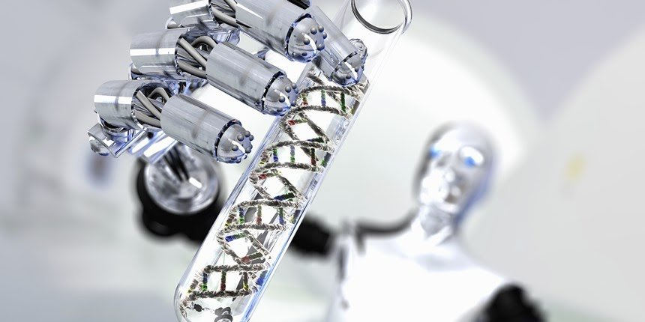
Why Big Pharma and biotech are betting big on AI
https://www.nbcnews.com/mach/amp/ncna852246
3/01/18 revision

Slide 3
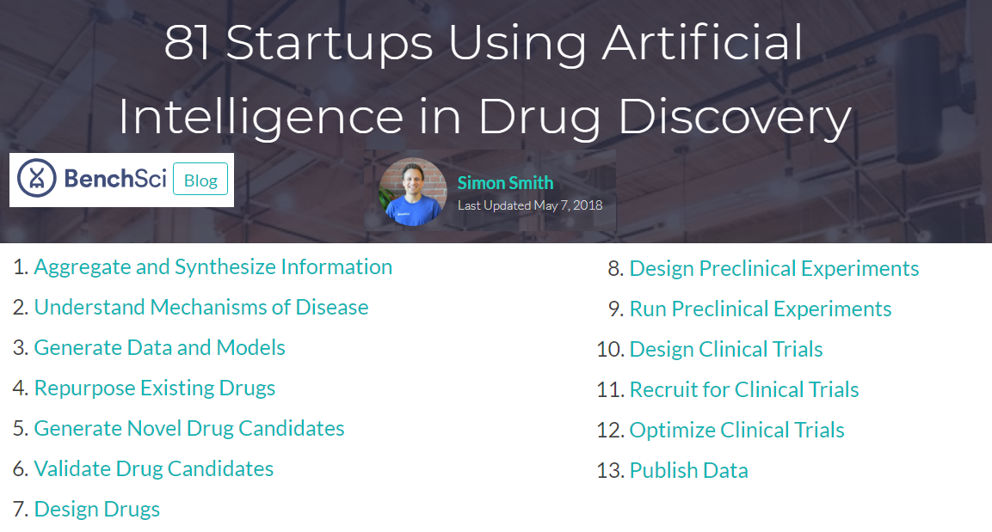

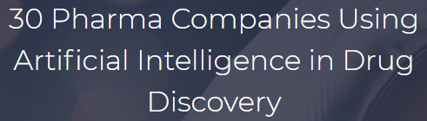

An increasing wave of AI users
AbbVie
AstraZeneca
Astellas
Boehringer Ingelheim
Evotech
Genentech
GSK
Janssen
Merck
Mitsubishi Tanabe
Nestlé
Novartis
Pfizer
Sanofi
Santen
Servier
Sumitomo Dainippon
Takeda
Wave Life Sciences
Blog link
Blog link
1/04/19 revision

Slide 4
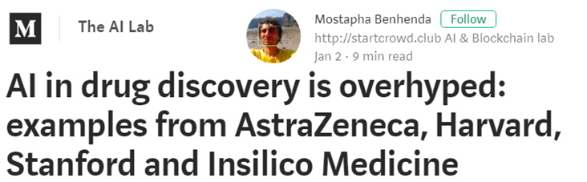
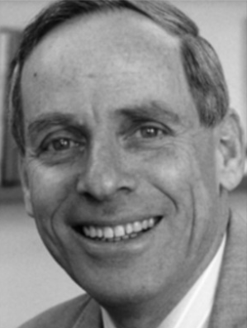
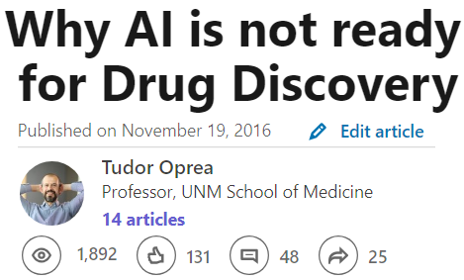
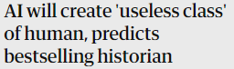
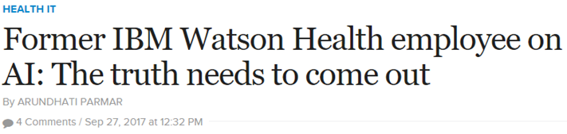
…Not everyone agrees
My colleagues, they study artificial intelligence; me, I study natural stupidity.
Amos Tversky
Quote link
Paper link
Book by Yuval N, Harari link
Paper link
Quote credit: Andrew Maynard
5/24/18 revision

Slide 5
AI vs Machine learning
“Machine learning is the study of computer algorithms that improve automatically through experience.” -- Tom M. Mitchell
“Artificial intelligence is the science and engineering of making computers behave in ways that, until recently, we thought required human intelligence.” -- Andrew Moore
In contrast to machine learning, AI is a moving target, and its definition changes as its related technological advancements turn out to be further developed. -- Roberto Iriondo link
1/03/19 revision

Slide 6


Components of IDG Consortium
RFA-RM-16-026 (DRGC) | GPCR | U24 DK116195: Bryan Roth, M.D., Ph.D. (UNC) Brian Shoichet, Ph.D. (UCSF)
 | Ion Channel | U24 DK116214: Lily Jan, Ph.D. (UCSF) Michael T. McManus, Ph.D. (UCSF)
 | Kinase | U24 DK116204: Gary L. Johnson, Ph.D. (UNC)
RFA-RM-16-025 (RDOC) |  | U24 TR002278: Stephan C. Schürer, Ph.D. (UMiami) Dusica Vidovic, Ph.D. (UMiami) Tudor Oprea, M.D., Ph.D. (UNM) Larry A. Sklar, Ph.D. (UNM)
RFA-RM-16-024 (KMC) |  | U24 CA224260: Avi Ma’ayan, Ph.D. (ISMMS) U24 CA224370: Tudor Oprea, M.D., Ph.D. (UNM)
RFA-RM-18-011 (CEIT) |  | Applications due date July 9, 2018
Further information
Email: idg.rdoc@gmail.com
Follow: @DruggableGenome
URLs:
https://druggablegenome.net/
https://commonfund.nih.gov/idg/
DRGC
RDOC
IDG Knowledge User-Interface
Email: pharos@mail.nih.gov
Follow: @IDG_Pharos
URL: https://pharos.nih.gov/
KMC
IT
Notes:
Current IDG awardees for the different components.
Note that CEIT – Cutting Edge Informatics Tool RFA is out and applications are due July 9th. This RFA focuses on developing predictive models and improved data visualization tools.
Links to further information and news updates.

Slide 7
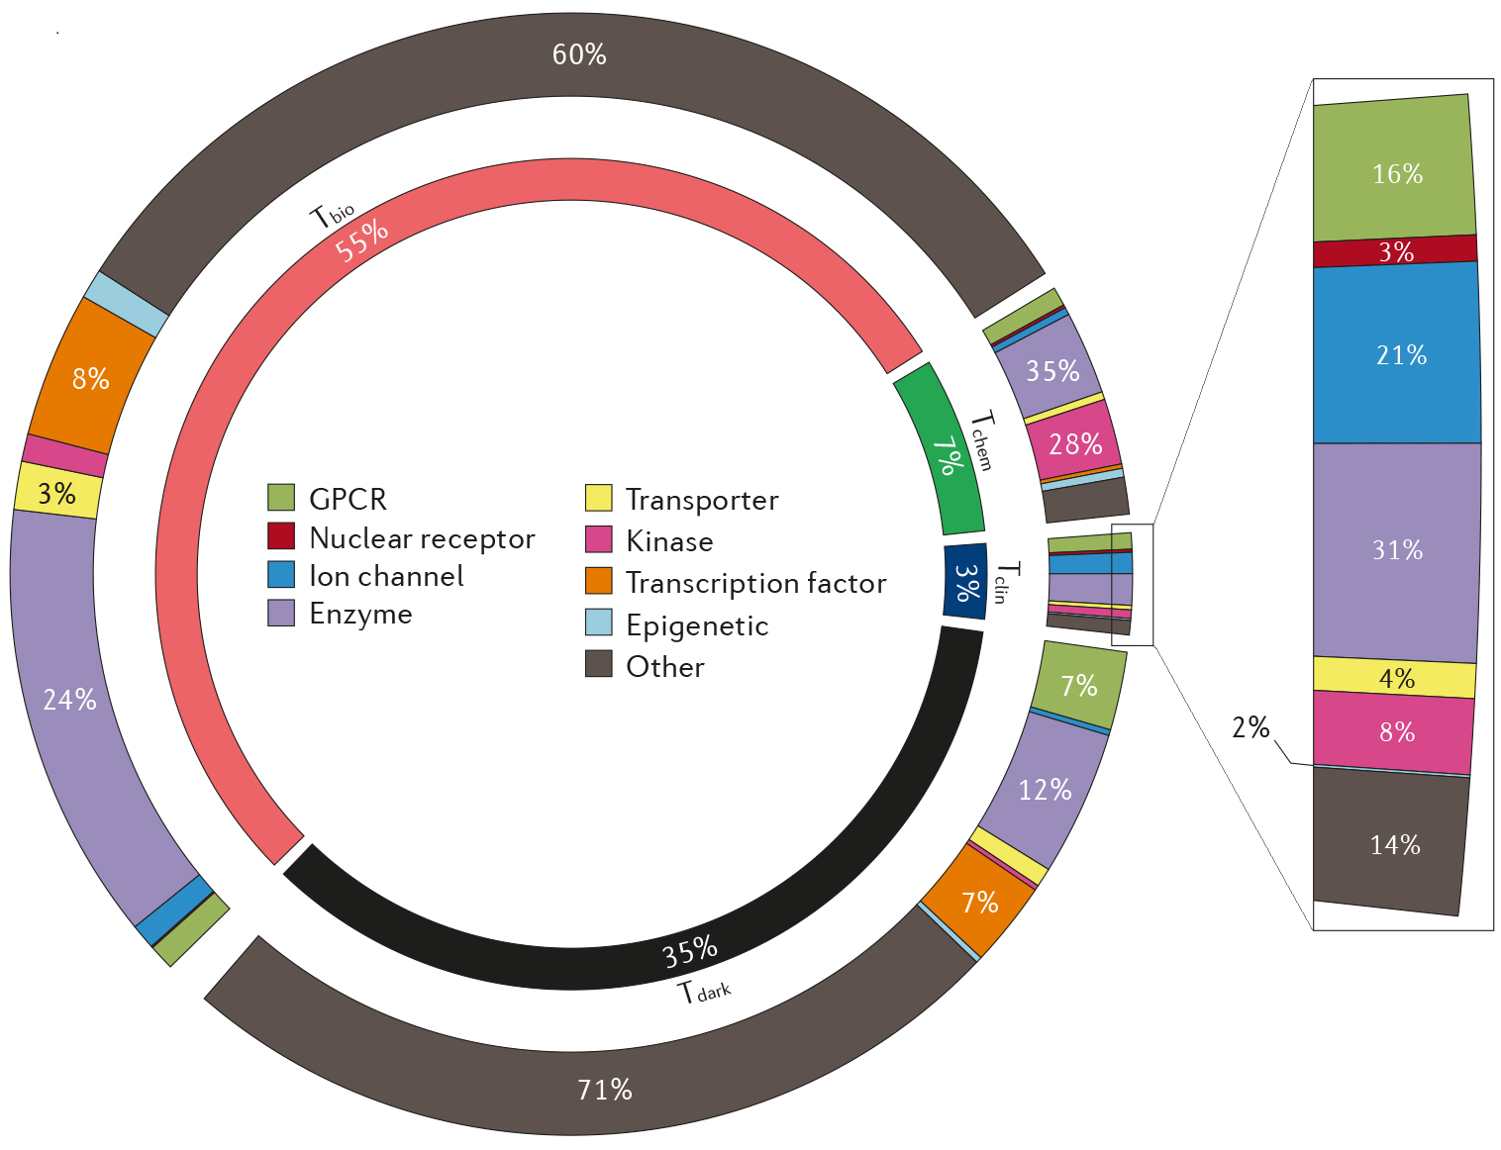
Target Development Level
Most protein classification schemes are based on structural and functional criteria.
For therapeutic development, it is useful to understand how much and what types of data are available for a given protein, thereby highlighting well-studied and understudied targets.
Tclin: Proteins annotated as drug targets
Tchem: Proteins for which potent small molecules are known
Tbio: Proteins for which biology is better understood
Tdark: These proteins lack antibodies, publications or Gene RIFs
T. Oprea et al., Nature Rev. Drug Discov. 2018, https://www.nature.com/articles/nrd.2018.14
3/23/18 revision

Slide 8
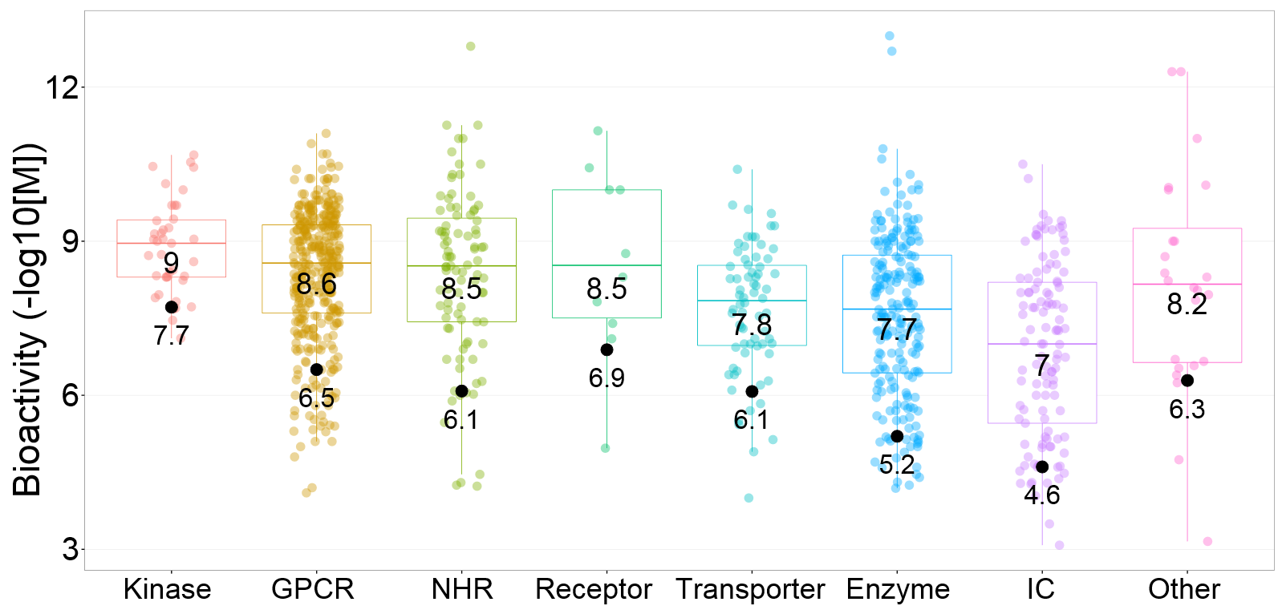
D-T Development Level 1
Tclin proteins are associated with drug Mechanism of Action (MoA) – NRDD 2017
Tchem proteins have bioactivitis in ChEMBL and DrugCentral, + human curation for some targets
Kinases: <= 30nM
GPCRs: <= 100nM
Nuclear Receptors: <= 100nM
Ion Channels: <= 10μM
Non-IDG Family Targets: <= 1μM
Bioactivities of approved drugs (by Target class)
ChEMBL: database of bioactive chemicals
https://www.ebi.ac.uk/chembl/
DrugCentral: online drug compendium
http://drugcentral.org/
R. Santos et al., Nature Rev. Drug Discov. 2017, https://www.nature.com/articles/nrd.2016.230
10/19/16 revision

Slide 9
D-T Development Level 2
Tbio proteins lack small molecule annotation cf. Tchem criteria, and satisfy one of these criteria:
protein is above the cutoff criteria for Tdark
protein is annotated with a GO Molecular Function or Biological Process leaf term(s) with an Experimental Evidence code
protein has confirmed OMIM phenotype(s)
Tdark (“ignorome”) have little information available, and satisfy these criteria:
PubMed text-mining score from Jensen Lab < 5
<= 3 Gene RIFs
<= 50 Antibodies available according to antibodypedia.com
8/20/15 revision

Slide 10
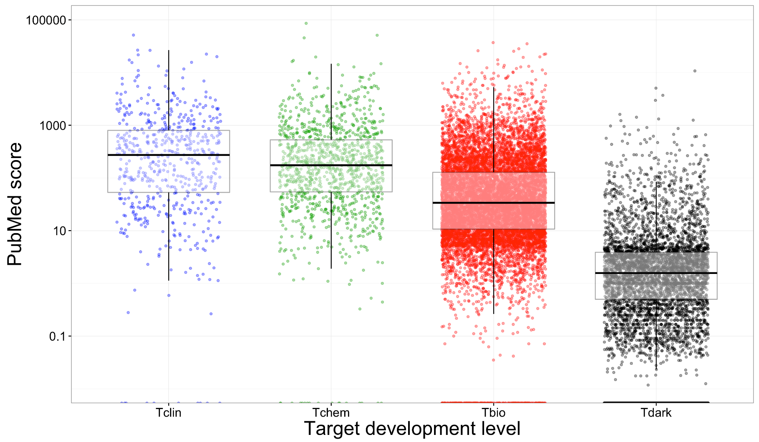
TDL vs Publications
251
We used name entity recognition software (from LJ Jensen’s lab) to evaluate nearly ~28 million abstracts (including ~2M full text articles) to derive a publication score per protein
167
PubMed counts
31.9
0.32
Target development level
P.F. Sune, et all, Methods 2105, 74:83-89
3/14/18 revision

Slide 11
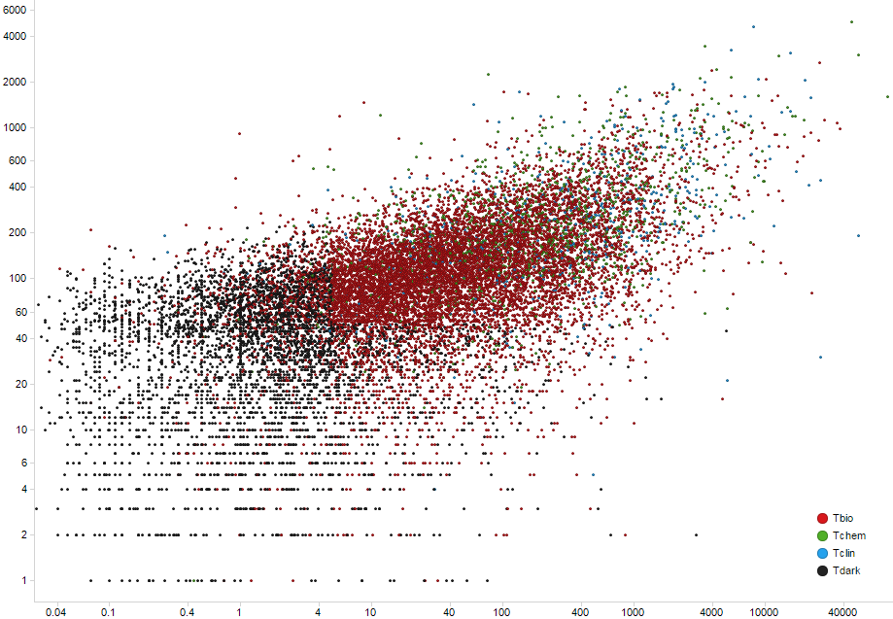
Antibodies vs Publications
Antibody Count
Nr of antibodies reflects our ability to characterize proteins. The “ignorome” has fewer such tools.
PubMed Count
Human proteome (20,186 proteins). Spearman R = 0.68. Axes in log scale.
Antibodypedia.com
8/31/16 revision

Slide 12
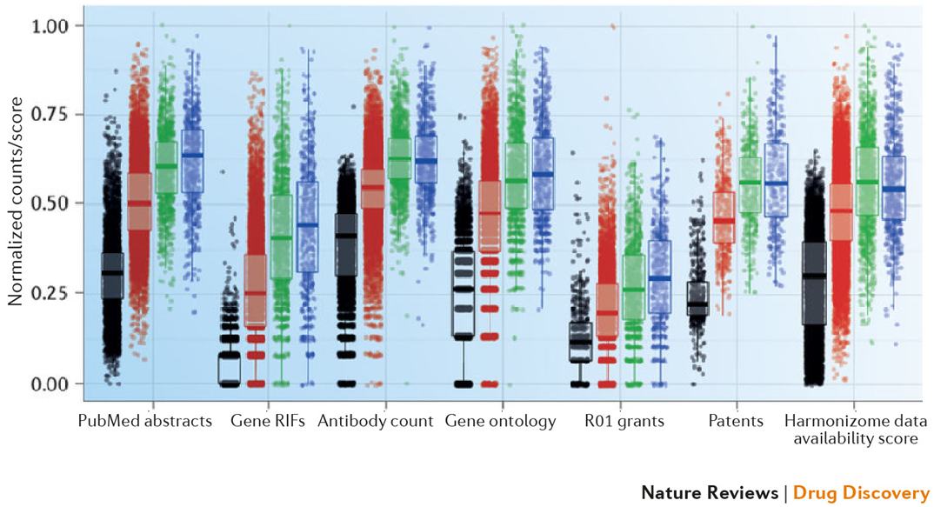
TDL: External Validation
Tdark parameters differ from the other TDLs across the 4 external metrics cf. Kruskal-Wallis post-hoc pairwise Dunn tests
T. Oprea et al., Nature Rev. Drug Discov. 2018, https://www.nature.com/articles/nrd.2018.14
2/23/18 revision

Slide 13
Take Home Message There is a Knowledge Deficit
~35% of the proteins remain
poorly described (Tdark)
~11% of the Proteome (Tclin & Tchem) are currently targeted by small molecule probes
Choosing to work on dark genes is a high-risk endeavor
(Funders are less likely to award grants for Tdark)
3/12/18 revision

Slide 14
What do we know about diseases?
There are between 9,000 and 18,000 disease concepts
Pharos/TCRD tracks ~9000 disease via Disease Ontology, and ~6000 rare disease via eRAM
DISEASES tracks (with high confidence) 4,561 unique diseases, annotated to 15,818 genes. 50% of diseases have 5 or more gene annotations, and 50% of genes are annotated to 3 or more diseases.
Most annotated disease are cancer, intellectual disability, diabetes mellitus, kidney & breast cancer, obesity and neurodegenerative diseases.
Most annotated genes are TNF, CRP, IL6, ALB, IL1B, TP53, POMC, INS, IL10 and KANTR.

Slide 15
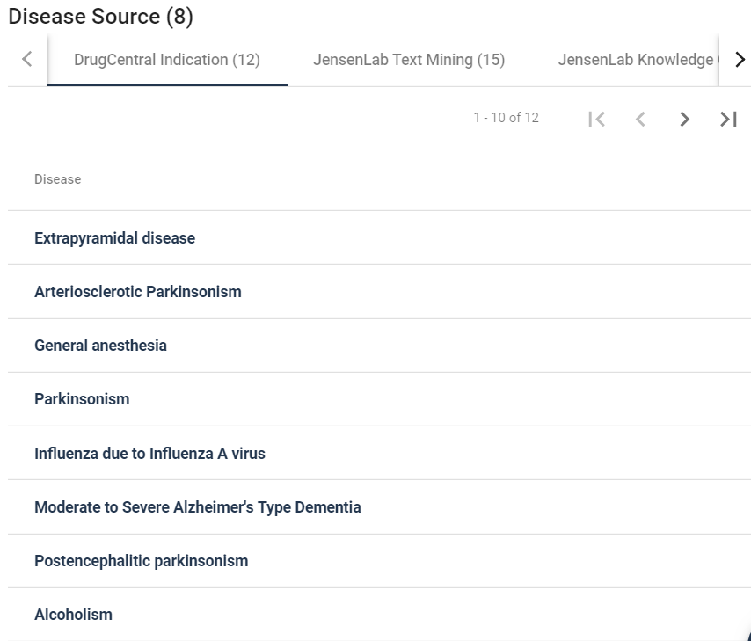
protein-Disease associations are Complex
The IDG KMC tracks more ~10 information channels for protein-disease associations, accessible via the Pharos portal.
Our challenge is to harmonize disease concepts, and to enable computational use: e.g., GRIN2A with GRIN1 form the Glutamate NMDA receptor, MoA drug target for memantine (Alzheimer’s).
The challenge for ML & AI: How to prioritize targets? i.e., which protein-disease associations are clinically actionable?
(involved is not the same as committed)
https://pharos-beta.ncats.io/targets/GRIN2A
10/07/18 revision

Slide 16
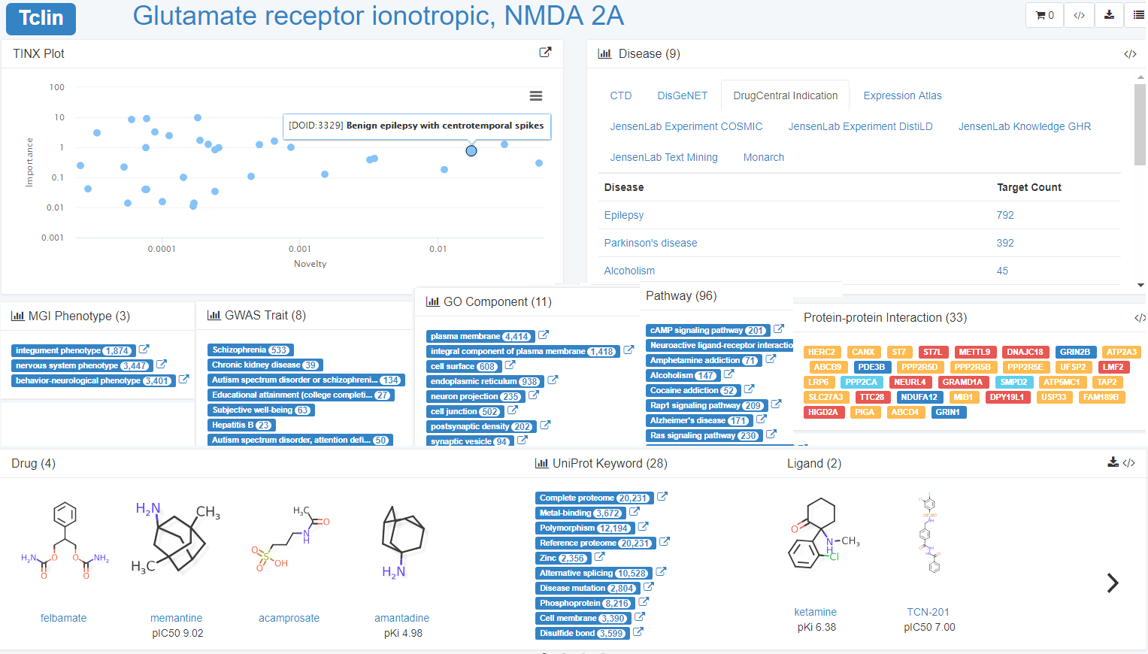
Machine learning readiness: Pharos
https://pharos.nih.gov/idg/targets/GRIN2A
11/13/18 revision

Slide 17
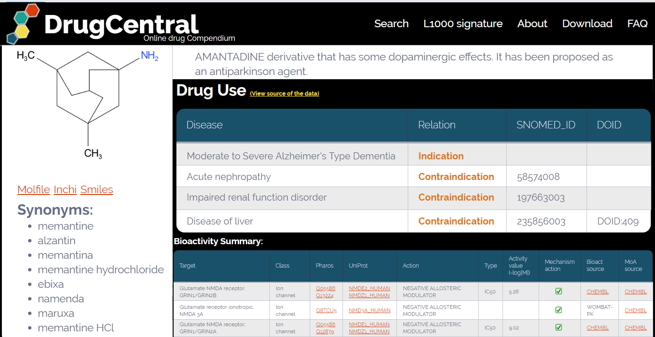
ML readiness: DrugCentral
http://drugcentral.org/drugcard/1679
10/16/18 revision

Slide 18
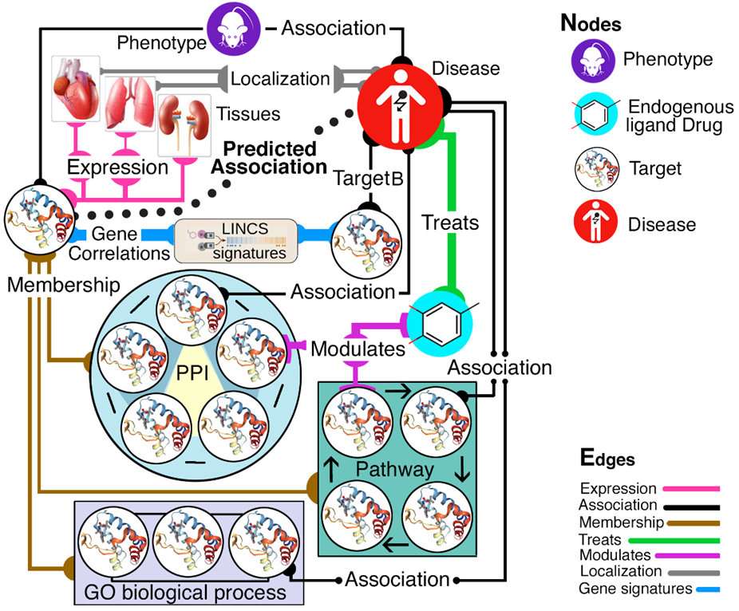
Protein knowledge graphs
IDG KMC2 seeks knowledge gaps across the five branches of the “knowledge tree”:
Genotype; Phenotype; Interactions & Pathways; Structure & Function; and Expression, respectively.
We can use biological systems network modeling to infer novel relationships based on available evidence, and infer new “function” and “role in disease” data based on other layers of evidence
Primary focus on Tdark & Tbio
O. Ursu, T Oprea et al., IDG2 KMC
2/01/18 revision

Slide 19
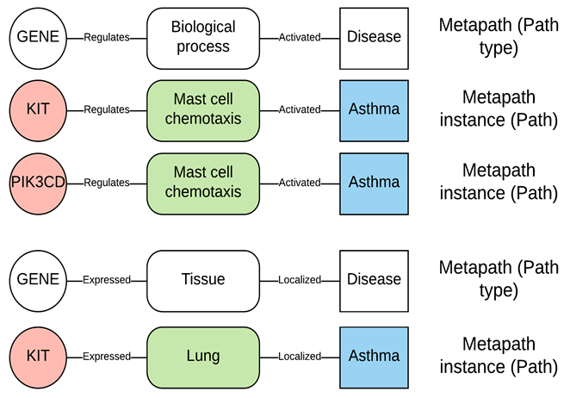
The Metapath approach
a meta-path is a path consisting of a sequence of relations defined between different object types (i.e., structural paths at the meta level)
Our metapaths encode type-specific network topology between the source node (e.g., Protein) and the destination node (e.g., Disease).
This approach enables the trans-formation of assertions/evidence chains of heterogeneous biological data types into a ML ready format.
Similar assertions or evidence form metapaths (white).
Instances of metapath (paths) are used to determine the strength of the evidence linking a gene to disease/phenotype/function.
G. Fu et al., BMC Bioinformatics 2016, 17:160 is an early example for drug-target interactions
10/01/18 revision

Slide 20
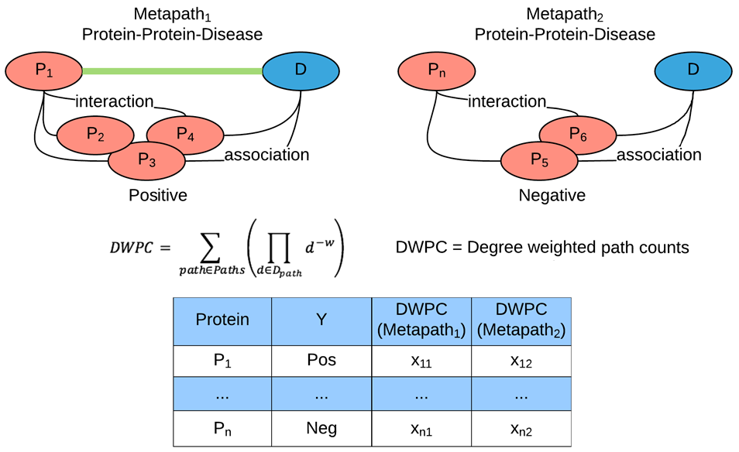
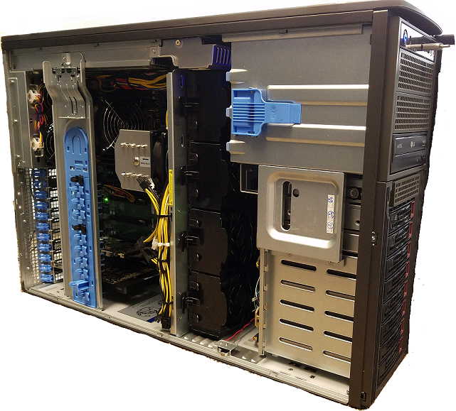
Machine learning as precursor to AI
one protein-disease association at the time
Genes associated with a disease/phenotype are positive examples, whereas genes lacking the same association are negative examples. The Metapath approach transforms assertions/evidence chains into classification problems that can be solved using suitably designed machine learning algorithms.
O. Ursu, T Oprea et al., IDG2 KMC
2/01/18 revision

Slide 21
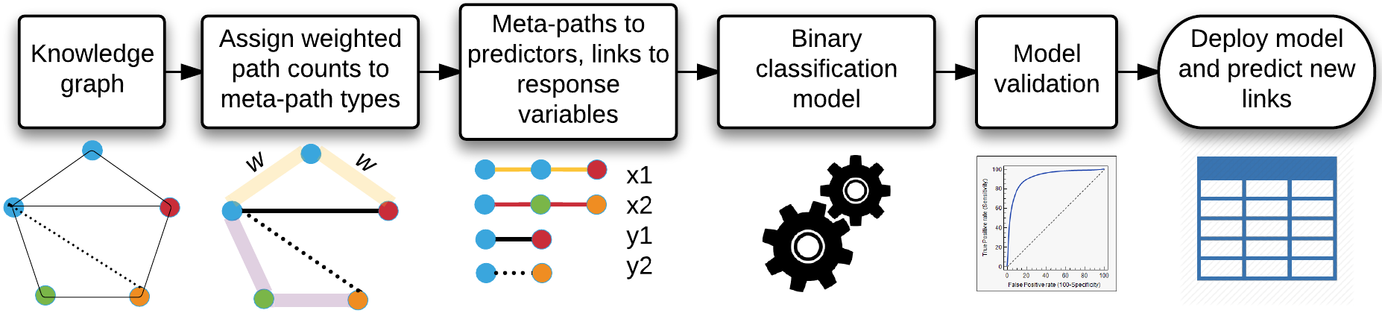
METAPATH ALGORITHM WORKFLOW
A meta-path encodes type-specific network topology between the source node (e.g., Protein target) and the destination node (e.g., Disease or Function)
Target –– (member of) → PPI Network ← (member of) –– Protein –– (associated with) → Disease
Target –– (expressed in) → Tissue ← (localized in) –– Disease
O. Ursu, T Oprea et al., IDG2 KMC
2/01/18 revision

Slide 22
automated data aggregation for ML
Data source | Data type | Data points
CCLE | Gene expression | 19,006,134
GTEx | Gene expression | 2,612,227
Protein Atlas | Gene & Protein expression | 949,199
Reactome | Biological pathways | 303,681
KEGG | Biological pathways | 27,683
StringDB | Protein-Protein interactions | 5,080,023
Gene ontology | Biological pathways & Gene function | 434,317
InterPro | Protein structure and function | 467,163
ClinVar | Human Gene - Disease/Phenotype associations | 881,357
GWAS | Gene - Disease/Phenotype associations | 54,360
OMIM | Human Gene - Disease/Phenotype associations | 25,557
UniProt Disease | Human Gene - Disease/Phenotype associations | 5,365
JensenLab DISEASE | Gene - Disease associations from text mining | 44,829
NCBI Homology | Homology mapping of human/mouse/rat genes | 70,922
IMPC | Mouse Gene - Phenotype associations | 2,153,999
RGD | Rat Gene - Phenotype associations | 117,606
LINCS | Drug induced gene signatures | 230,111,315
We developed automated methods for data collection (TCRD), visualization (Pharos) and data aggregation.
These aggregated datasets were used to build machine learning models for 20+ disease and 73 mouse phenotype.
Each knowledge graph contains ~22,000 metapaths and 284 million path instances.
O. Ursu et al., manuscript in preparation
10/07/18 revision

Slide 23
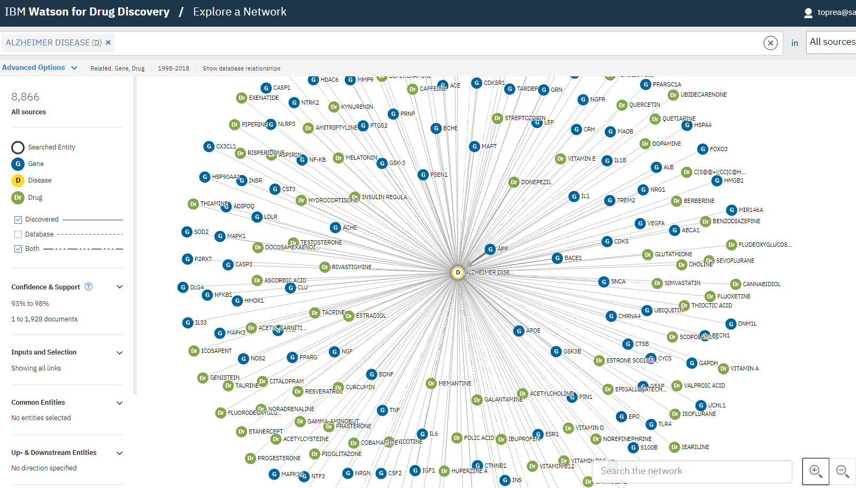
Wdd view of Alzheimer’s disease
Source: IBM Watson for Drug Discovery
10/22/18 revision

Slide 24
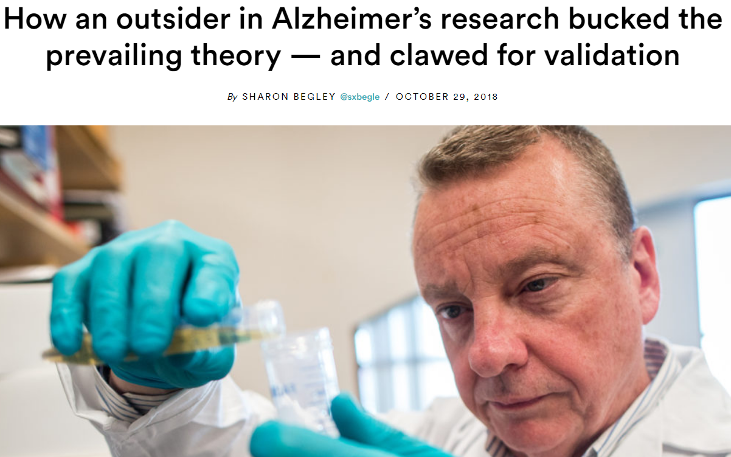
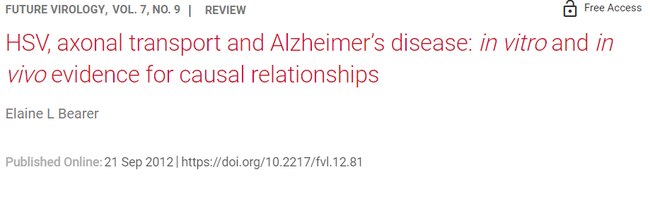
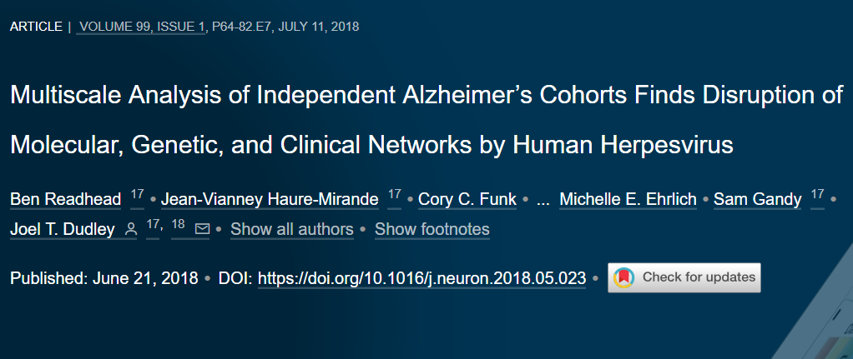
does infection cause Alzheimer’s?
https://www.futuremedicine.com/doi/10.2217/fvl.12.81
https://www.statnews.com/2018/10/29/alzheimers-research-outsider-bucked-prevailing-theory/
http://stm.sciencemag.org/content/8/340/340ra72
https://www.cell.com/neuron/pdfExtended/S0896-6273(18)30421-5
11/05/18 revision

Slide 25
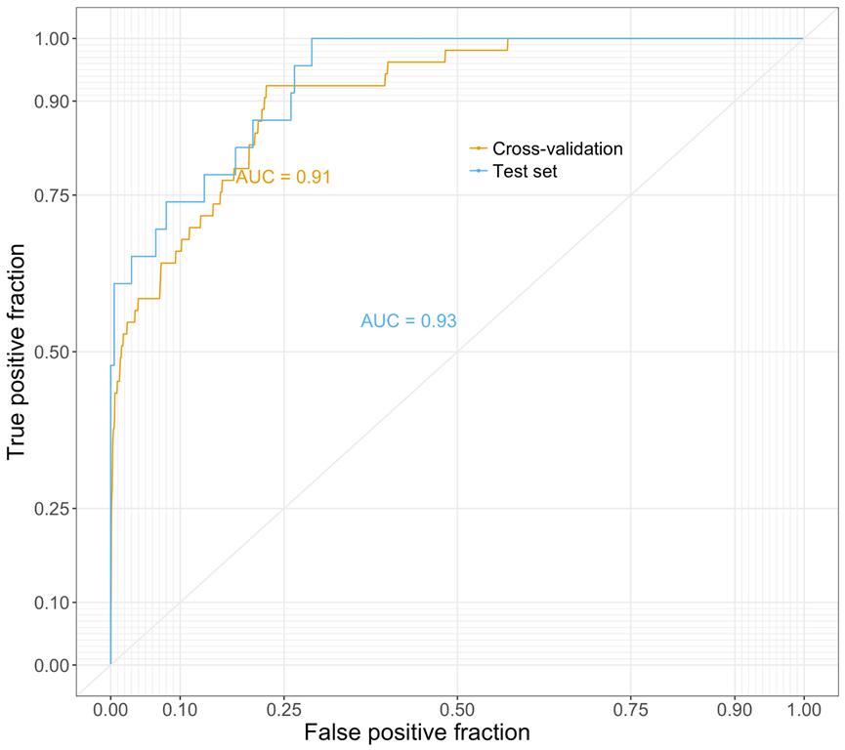
Alzheimer’s disease metapath Model
Build data matrix from “Alzheimer’s disease” in TCRD subset
protein knowledge graph along metapaths:
Protein – Protein Interactions
Pathways
GO terms
Gene expression
...
Training set: 53 genes associated with Alzheimer’s disease (positives) and 3,952 genes associated with other pathologies (negatives) ⬅ from OMIM
Test set: 23 genes associated with Alzheimer's (positives) and 200 genes not associated with Alzheimer's (negatives) ⬅ from Text Mining
Random forest binary classifier (RF), using XGBoost & 5-fold cross-validation.
Weighted model is better than balanced model
 | Bal. | Predicted
Actual |  | Pos | Neg
 | Pos | 16 | 7
 | Neg | 94 | 106
 | Wtd | Predicted
Actual |  | Pos | Neg
 | Pos | 20 | 3
 | Neg | 41 | 159
ML work by Oleg Ursu
2/27/18 revision

Slide 26
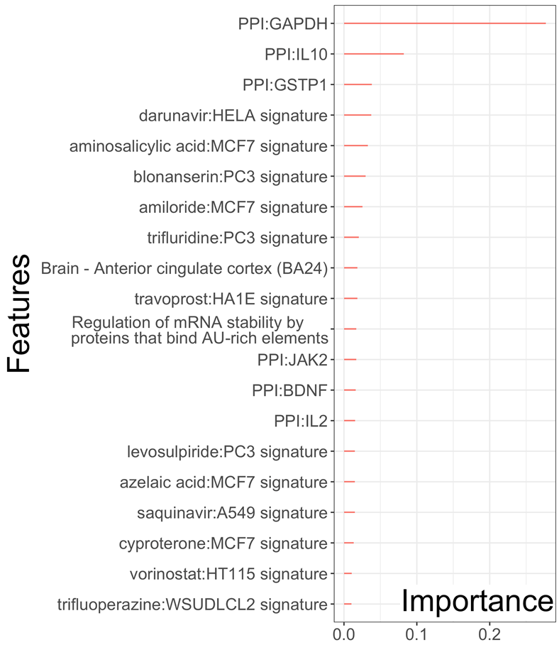
Alzheimer’s Disease RF classifier: variable importance Plot
The top most important features are interactions with proteins mediating inflammatory processes (JAK2/Tclin, IL10 & IL2 / Tchem), response to oxidative stress (GSTP1/Tchem), nervous system development (BDNF/Tbio) and glycolysis (GAPDH/Tchem).
LINCS drug-induced gene expression perturbations are the largest category of features for these predictions.
Brain cortex expression is a necessary requirement.
One Reactome pathway (AU-rich mRNA elements binding proteins) is also important.
Weighted approached showed better performance in the test set for Alzheimer's Disease, Schizophrenia, and Dilated Cardiomyopathy.
ML work by Oleg Ursu
4/23/18 revision

Slide 27
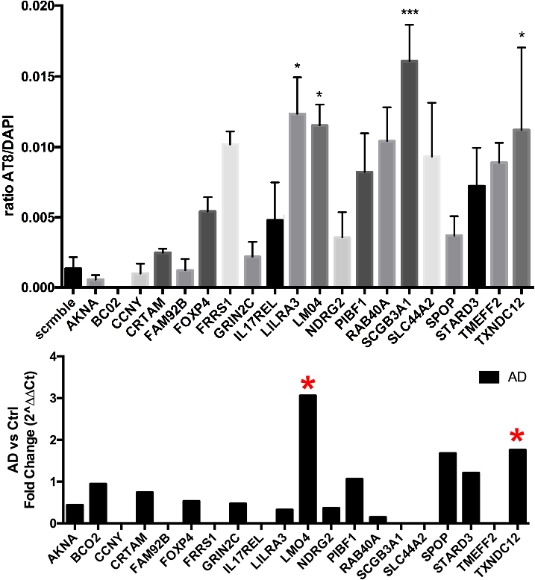
Alzheimer’s Disease ML Validation
SHSY5Y cells were transfected with siRNA against the top 20 predicted genes (AKNA, BC02, CCNY, CRTAM, FAM92B, FOXP4, FRRS1, GRIN2C, 1L17REL, LILRA3, LM04, NDRG2, PIBF1, RAB40A, SCGB3A1, SLC44A2, SPOP, STARD3, TMEFF2, TXNDC12).
After 48 hrs., 50% of the media was replaced with CM derived from RAW macrophage cells. After 24 hrs., the SHSY5Y cells were fixed & stained with AT8, a pS²⁰²-tau specific mAb, & DAPI. Cellomics® high-content micro-scopy showed that siRNA knockdown of LILRA3, LM04, SCGB3A1 and TXNDC12 significantly increased pS²⁰²-tau/DAPI ratio compared to siScramble control.
qPCR experiment (11/12/18) shows that lower expression of LMO4 & TXNDC12 correlates with tau pathology
Human autopsy brains showed differential expression for FOXP4, LILRA3, RAB40A, TMEFF2, LMO4 & GAPDH in iPSCs derived from DS & sporadic AD pts (DS1, sAD2.1 cells).
AD validation work by Jessica Binder & Kiran Bhaskar, funded by U24CA224370-S2 supplement
11/14/18 revision

Slide 28
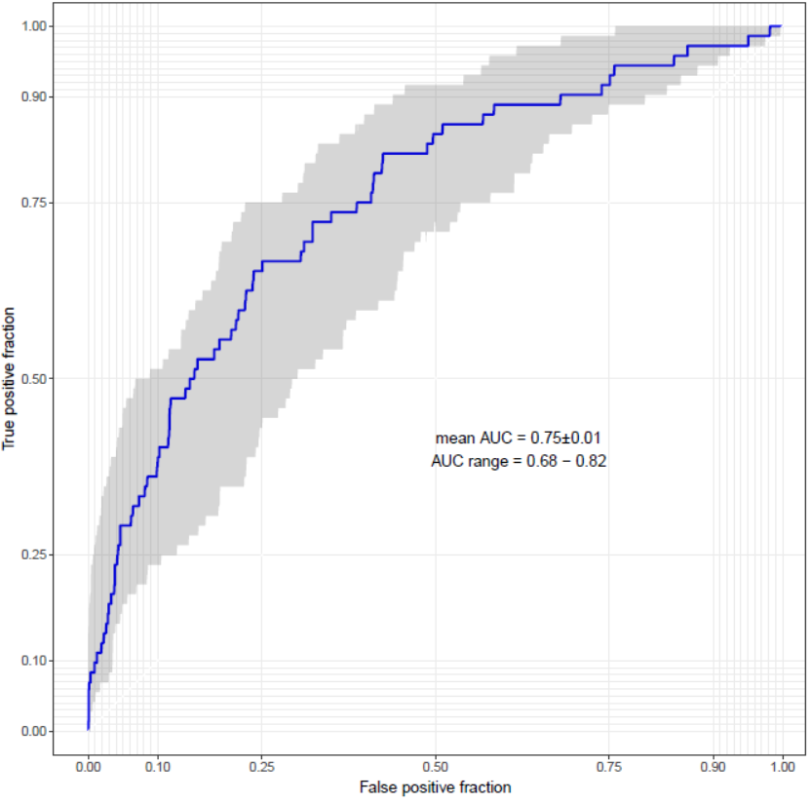
Schizophrenia metapath Model (Nature)
TCRD subset data matrix for Schizophrenia
protein knowledge graph along metapaths:
Protein – Protein Interactions
Pathways, GO terms, LINCS
Gene expression
...
Training set: 357 genes associated with Schizophrenia (positives) from Nature 511:421–427 & Schizophrenia drugs targets and 7,272 genes random genes from GWAS studies not known to be associated with Schizophrenia (true negatives not available)
Test set: Not used.
Confusion matrix based on 20% crsoss-validaiton, i.e., 72 positive and 1454 negative genes excluded from the training set.
XGBoost binary classifier & 5-fold cross-validation (100x).
Total grid size: 1,944; x-val AUC ~0.69-0.81
 | Wtd | Predicted
Actual |  | Pos | Neg
 | Pos | 54 | 18
 | Neg | 329 | 1126
ML work by Oleg Ursu
5/24/18 revision

Slide 29
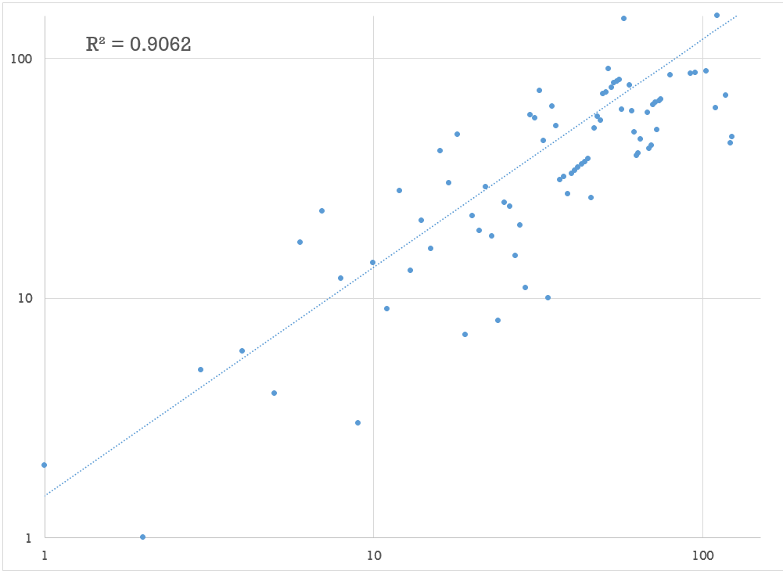
metapath Model stability
TCRD data matrix for Schizophrenia
Random forest binary classifier (RF), using XGBoost & 5-fold cross-validation (100x).
Different seeds as a starting point for model building & prediction yield slightly different ranked gene lists
These ranks are highly correlated – as illustrated for the 12,608 genes predicted for Schizophrenia (see plot)
Z-score (model output) Spearman Rank for top 120 SZ genes: R² = 0.78 (not shown)
We are also running different disease models (e.g., AD) using different starting points – so far models seem reproducible
ML work by Cristian Bologa
11/29/18 revision

Slide 30
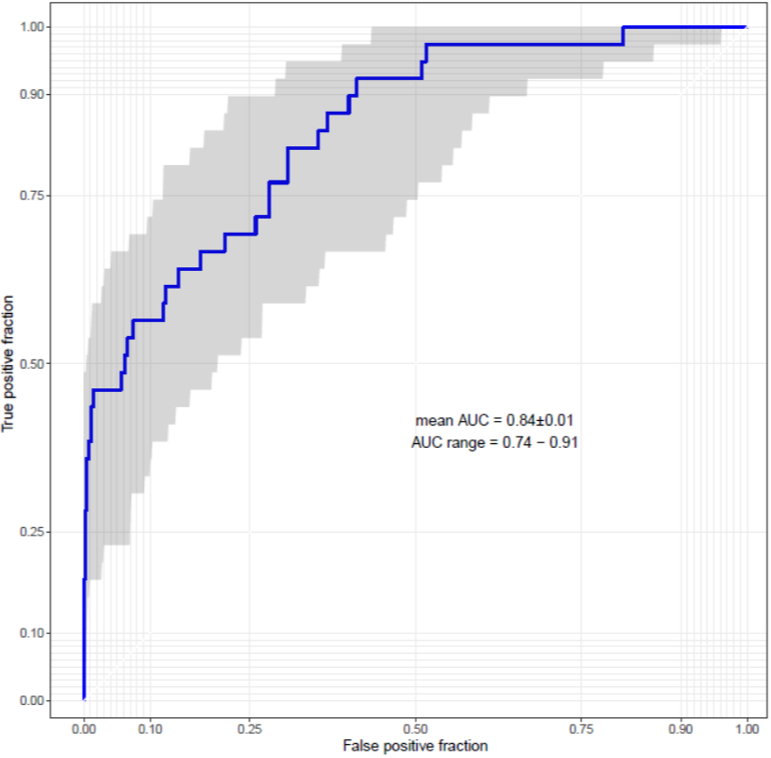
Schizophrenia metapath Model (literature)
TCRD subset data matrix for Schizophrenia
protein knowledge graph along metapaths:
Protein – Protein Interactions
Pathways, GO terms, LINCS
Gene expression
...
Training set: 195 genes associated with Schizophrenia (positives) from DISEASES, GHR, GWAS-C, STRING-DB, MALACARDS and 3,810 genes from OMIM not known to be associated with Schizophrenia (true negatives not available)
Test set: Not used.
Confusion matrix based on 20% crsoss-validaiton, i.e., 72 positive and 1454 negative genes excluded from the training set.
XGBoost binary classifier & 5-fold cross-validation (101x).
Total grid size: 1,944; x-val AUC ~0.74-0.90
ML work by Tudor Oprea
1/16/19 revision

Slide 31
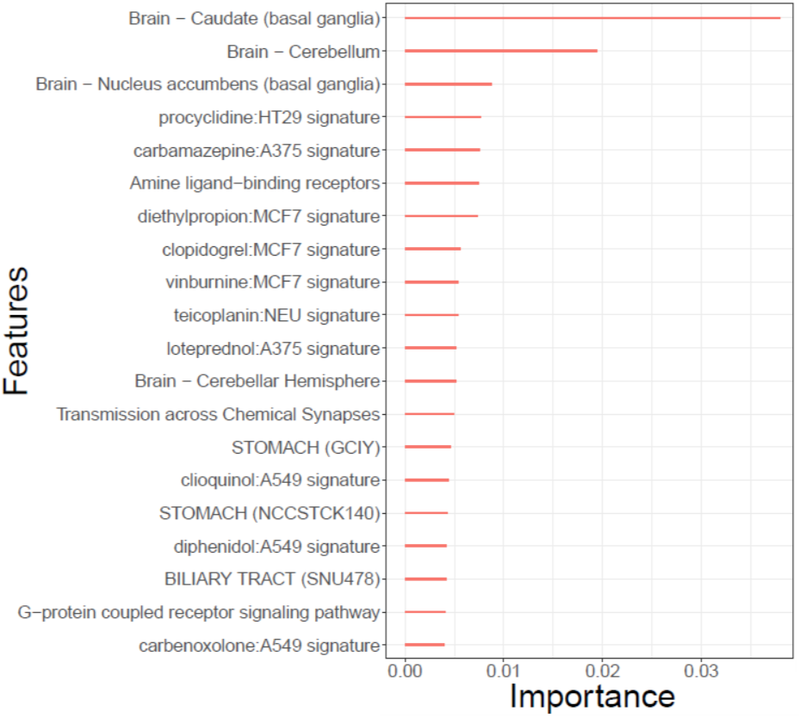
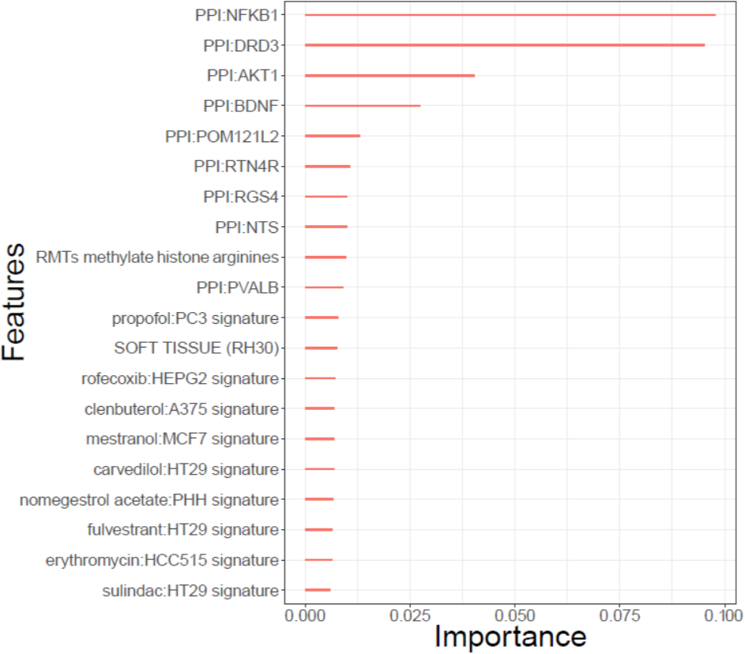
Schizophrenia disease classifier: variable importance Plot x2
Genes | 357
Source | http://dx.doi.org/10.1038/nature13595
AUC | 0.75±0.01
Genes | 357
Source | DISEASES, GHR, GWAS-C, STRING-DB, MALACARDS
AUC | 0.84±0.01
ML work by Tudor Oprea
1/16/19 revision

Slide 32

Top geneS in Schizophrenia
Top 10 Genes, 357 Genes Model
Top 10 Genes, 195 Genes Model
Accession | Symbol | Name
Q96CT7 | CCDC124 | Coiled-coil domain-containing protein 124
Q9BWL3 | C1orf43 | Uncharacterized protein C1orf43
P03901 | MT-ND4L | NADH-ubiquinone oxidoreductase chain 4L
P03923 | MT-ND6 | NADH-ubiquinone oxidoreductase chain 6
P60602 | ROMO1 | Reactive oxygen species modulator 1
P00403 | MT-CO2 | Cytochrome c oxidase subunit 2
O96000 | NDUFB10 | NADH dehydrogenase [ubiquinone] 1 beta subcomplex subunit 10
Q14602 | ID2B | Putative DNA-binding protein inhibitor ID-2B
P30044 | PRDX5 | Peroxiredoxin-5, mitochondrial
Q8WVX3 | C4orf3 | Uncharacterized protein C4orf3
Accession | Symbol | Name
Q5SNV9 | C1orf167 | Uncharacterized protein C1orf167
B9ZVM9 | TCP10L2 | T-complex protein 10A homolog 2
Q8IXT2 | DMRTC2 | Doublesex- and mab-3-related transcription factor C2
Q86WS5 | TMPRSS12 | Transmembrane protease serine 12
Q8N6L0 | CCDC155 | Protein KASH5
Q3KNS1 | PTCHD3 | Patched domain-containing protein 3
Q96MA1 | DMRTB1 | Doublesex- and mab-3-related transcription factor B1
Q86WS3 | OOSP2 | Oocyte-secreted protein 2
Q8N7R1 | POM121L12 | POM121-like protein 12
Q86SH4 | PRNT | Putative testis-specific prion protein
Consensus
Accession | Symbol | Name
Q7RTT3 | SSX9 | Protein SSX9
P0CG32 | ZCCHC18 | Zinc finger CCHC domain-containing protein 18
F5GYI3 | UBAP1L | Ubiquitin-associated protein 1-like
Q14831 | GRM7 | Metabotropic glutamate receptor 7 | L-glutamate?
P28222 | HTR1B | 5-hydroxytryptamine receptor 1B | Frovatriptan? Rizatriptan?
A6NM43 | CCT8L1P | Putative T-complex protein 1 subunit theta-like 1
Q5JU69 | TOR2A | Torsin-2A
Q01130 | SRSF2 | Serine/arginine-rich splicing factor 2
ML work by Tudor Oprea
1/16/19 revision

Slide 33
Disease metapath ML models (1)
Human Diseases | genes | URL
Alzheimer’s Disease | 53 | https://omim.org/entry/104300
Schizophrenia | 357 | http://dx.doi.org/10.1038/nature13595
Schizophrenia (2) | 195 | Literature based list
Bipolar disorder | 62 | Literature based list
Parkinson disease | 55 | https://omim.org/phenotypicSeries/PS168600
Epileptic encephalopathy, early infantile | 55 | https://omim.org/phenotypicSeries/PS308350
Epilepsy | 190 | DISEASES
Mental Retardation, Autosomal Recessive | 51 | https://omim.org/phenotypicSeries/PS249500
Mental Retardation, X-Linked | 50 | https://omim.org/phenotypicSeries/PS309530
Mental Retardation, Autosomal Dominant | 120 | https://omim.org/phenotypicSeries/PS156200
Mental Retardation (combined) | 203 | The above 3 MR lists
Spastic paraplegia | 53 | https://omim.org/phenotypicSeries/PS303350
Charcot-Marie-Tooth disease | 56 | https://omim.org/phenotypicSeries/PS118220
Amyotrophic lateral sclerosis | 69 | https://omim.org/phenotypicSeries/PS105400
Autistic Spectrum Disorder | 87 | DISEASES, OMIM, UniProt, DisGeNet, GHR
O. Ursu et al., manuscript in preparation
1/03/19 revision

Slide 34
Take Home Message not all models are equal
Predictivity between models for the same disease differ (even using the same ML method) due to variations in input data
Data Matters!!!
High quality data is really hard to obtain
1/03/19 revision

Slide 35
Disease metapath ML models (2)
Human Diseases | genes | URL
Type 2 Diabetes Mellitus (OMIM) | 51 | https://omim.org/entry/125853
Type 2 Diabetes Mellitus (GWAS) | 54 | Causal T2D transcripts (Mark McCarthy)
Obesity | 62 | https://omim.org/entry/601665
Stroke | 137 | DISEASES, MalaCards, TIN-X
Asthma, Susceptibility To | 62 | https://omim.org/entry/600807
Asthma | 75 | UniProt, DISEASES, MalaCards, DRUGCENTRAL
Myocardial Infarction, Susceptibility To | 70 | https://omim.org/entry/608446
Dilated Cardiomyopathy | 51 | https://omim.org/phenotypicSeries/PS115200
Cardiomyopathy, familial hypertrophic | 50 | https://omim.org/phenotypicSeries/PS192600
Atrial fibrillation, familial | 52 | https://omim.org/phenotypicSeries/PS608583
Long QT Syndrome | 52 | https://omim.org/phenotypicSeries/PS192500
Deafness, autosomal recessive | 63 | https://omim.org/phenotypicSeries/PS220290
Deafness, autosomal dominant | 55 | https://omim.org/phenotypicSeries/PS124900
Cataract | 60 | https://omim.org/phenotypicSeries/PS116200
Retinitis pigmentosa | 88 | https://omim.org/phenotypicSeries/PS268000
Autophagy | 103 | GO, KEGG, UniProt
O. Ursu et al., manuscript in preparation
1/03/19 revision

Slide 36
Note on T2DM model
From: Mark McCarthy <mark.mccarthy@drl.ox.ac.uk> Sent: Friday, December 7, 2018 11:10 AM
The general summary is that we don’t see any enrichment for T2D associations in either exome or GWAS data from the predicted gene sets (however we slice them up).
But having that we don’t really see anything in the TRAINING set either: No association in the exomes, and a weak (just nominal) association in the GWAS data.
To be honest, I think, now we’ve taken a look at it, we’d all question the training set: I had missed that this came from OMIM, which is simply not a reliable source of information in this regard, and it’s certainly not something we would ever use to derive a set of “truth set” genes for a multifactorial trait like T2D as curation of that kind of information within OMIM was never prioritised. Few of the genes in the training set are ones that we would recognise as having evidence in favour of a role in diabetes.
1/03/19 revision

Slide 37
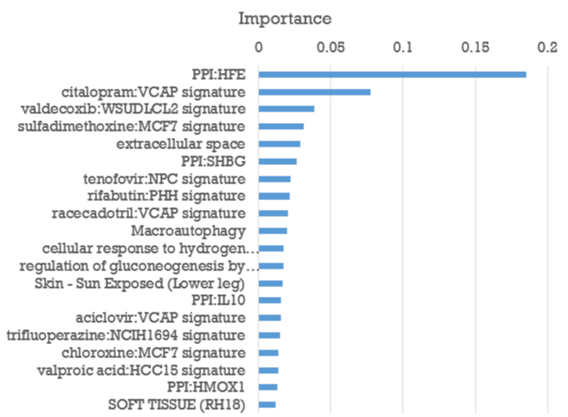
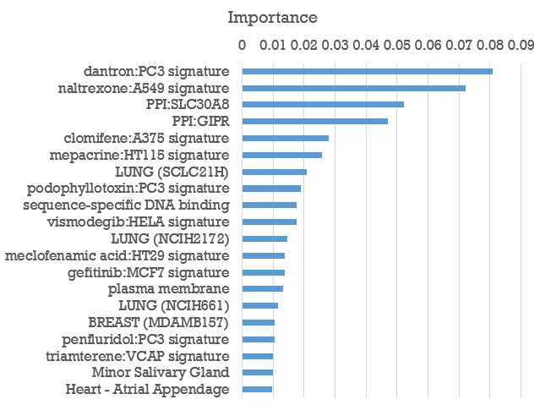
Type 2 diabetes mellitus classifier: variable importance Plot x2
Genes | 51
Source | https://omim.org/entry/125853
AUC | 0.72±0.02
Genes | 54
Source | Causal T2DM transcripts
AUC | 0.79±0.01
ML work by Tudor Oprea
1/16/19 revision

Slide 38
Disease metapath ML models (3)
Human Diseases | genes | URL
Hemochromatosis | 55 | https://omim.org/phenotypicSeries/PS235200
Drug Allergy | 78 | TIN-X, DISEASES, Literature
Food Allergy | 121 | TIN-X, DISEASES, MALACARDS
Agammaglobulinemia | 52 | DISEASES, Literature
Immunodeficiency | 53 | https://omim.org/phenotypicSeries/PS300755
Inflammatory Bowel Disease | 90 | https://omim.org/phenotypicSeries/PS266600
Irritable bowel syndrome | 108 | TIN-X, DRUGCENTRAL, Literature
O. Ursu et al., manuscript in preparation
1/03/19 revision

Slide 39
Disease metapath ML models (4)
Human Disease | genes | URL
Bladder Cancer | 74 | https://omim.org/entry/109800
Breast Cancer | 164 | https://omim.org/entry/114480
Renal Cell Carcinoma | 71 | https://omim.org/entry/144700
Ovarian Cancer | 85 | https://omim.org/entry/167000
Prostate Cancer | 98 | https://omim.org/entry/176807
Pancreatic Cancer | 52 | https://omim.org/entry/260350
Leukemia, Acute Myeloid | 55 | https://omim.org/entry/601626
Mouse Phenotype | genes | URL
enlarged heart | 67 | http://www.mousephenotype.org/data/phenotypes/MP:0000274
abnormal circulating cholesterol level | 160 | http://www.mousephenotype.org/data/phenotypes/MP:0000180
abnormal circulating glucose level | 155 | http://www.mousephenotype.org/data/phenotypes/MP:0000188
abnormal startle reflex | 194 | http://www.mousephenotype.org/data/phenotypes/MP:0001486
increased leukocyte cell number | 97 | http://www.mousephenotype.org/data/phenotypes/MP:0000218
decreased leukocyte cell number | 98 | http://www.mousephenotype.org/data/phenotypes/MP:0000221
abnormal grip strength | 156 | http://www.mousephenotype.org/data/phenotypes/MP:0001515
abnormal prepulse inhibition | 114 | http://www.mousephenotype.org/data/phenotypes/MP:0003088
abnormal locomotor activation | 270 | http://www.mousephenotype.org/data/phenotypes/MP:0003313
abnormal behavior | 152 | http://www.mousephenotype.org/data/phenotypes/MP:0004924
O. Ursu et al., manuscript in preparation
10/07/18 revision

Slide 40
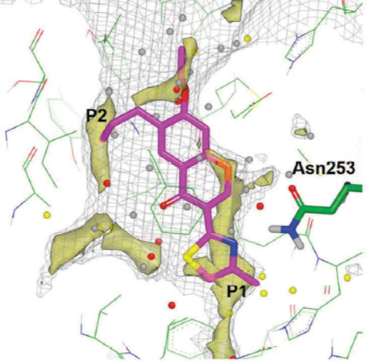
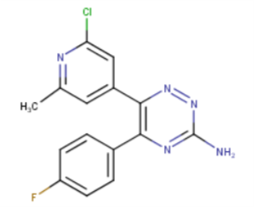
Top predicted ovarian cancer gene: A_{2A}R
Adenosine A2A Receptor (A_{2A}R) antagonists have been developed over many years for the potential treatment of central nervous system (CNS) disorders such as Parkinson’s disease
The hypothesis that extracellular adenosine in the tumor microenvironment is a critical mechanism in immune evasion has generated significant interest in the use of A_{2A}R antagonists in cancer
A_{2A}R was one of the first GPCRs to yield protein-ligand X-ray structures facilitating the use of Structure-Based Drug Design (SBDD), and multiple X-ray structures have now been solved with both antagonist and agonist ligands
A_{2A}R antagonists are now being studied clinically in immune oncology in what has become a competitive and rapidly developing field.
AstraZeneca and Heptares have progressed AZD4635 in combination with Duvalumab into Phase 1b clinical trials (NCT02740985) for Patients With Advanced Solid Malignancies, Non-Small Cell Lung Cancer (NSCLC), Metastatic Castrate-Resistant Prostate Carcinoma (mCRPC) & Colorectal Carcinoma (CRC).
Druggability analysis: pseudo-apo A_{2A}R binding site and an overlaid docking of a chromone ligand. The grey mesh shows the shape and size of the binding site; colored spheres represent calculated water molecules in the pseudo-apo site; yellow surfaces show the lipophilic hotspots.
AZD4635
Congreve M. et al., Expert Opin Drug Discov 2018, DOI: 10.1080/17460441.2018.1534825
11/29/18 revision

Slide 41
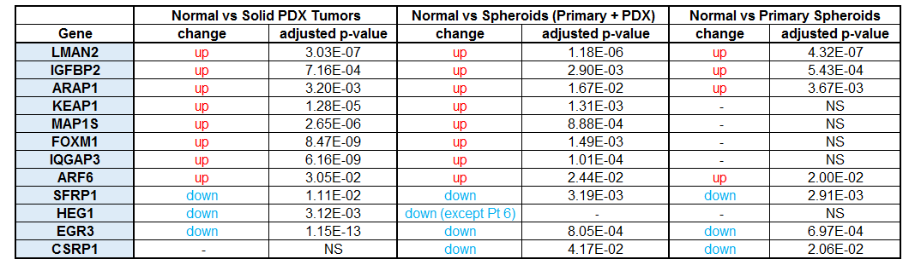
Top predicted genes in ovarian cancer
12 RNA samples in total from 4 patients:
primary spheroids (Pt3, Pt6, Pt9)
PDX solid tumors (omentum/ovary) (Pt3, Pt9, Pt29)
PDX spheroids (Pt3, Pt6, Pt9, Pt29)
From the top 63 genes (Machine Learning), 12 genes show significant changes in cancer cells.
10 of these 12 are significantly upregulated or downregulated in both xenograft solid tumors and spheroids (xenograft or primary). Another 24 genes were expressed but no change. 19 genes had low expression (under 200), and 6 genes were not expressed (including ADOR2A, top prediction)
Spheroid tumor & PDX work by Mara Steinkamp
11/14/18 revision

Slide 42
Top genes in ovarian cancer
Data from Pearce, OTM et al., Cancer Discov. 2018 8: 304–319
genomic data from biopsies of high-grade serous ovarian cancer metastases (36 patients)
Of the statistically relevant genes, 8 match the top 63 predicted MP-ML genes:
AHNAK, ALOX15, ATP2B4, CCNH, FOXM1, PCOLCE2, SFRP1, and TIPARP
ADARB1, AHNAK, ALOX15, ARAP1, ATP2B1, ATP2B4, CARD8, CCNH, CDK5RAP3, EGR3, FOXM1, FSTL3, GPX8, HEG1, IGFBP2, LMAN2, NME2, NR4A2, PCOLCE2, PHF11, PRMT6, PSMB10, PTGES2, RCAN3, S1PR3, SFRP1, SLC2A3, TIPARP, and TNFSF12 match MP-ML and the Pearce set.
ADORA2A, ARL2, CD226, COMMD1, COPS5, CSRP1, GDF15, GLS2, HDHD3, HES1, IQGAP1, LIMS1, MAP1S, MCM10, PLA2G10, PLA2G2D, PTGER2, RAB6A, RAD17, and TNFAIP6 are genes predicted by by MP-ML that match related genes in the Pearce set.
In total, 29 exact genes and 20 related genes from the top 63 are present in the Pearce set.
Comparisons by Angela Wandinger Ness
12/05/18 revision

Slide 43
Prostate cancer metapath Model
From: Artem Cherkasov <acherkasov@prostatecentre.com> Sent: Thursday, October 25, 2018 4:59 PM To: Tudor Oprea <TOprea@salud.unm.edu> Cc: Kriti Singh <ksingh@prostatecentre.com>; Michael Hsing <mhsing@prostatecentre.com> Subject: PCa genes
We cross-referenced your gene list with those that are overexpressed from our previous TCGA gene expression analysis (comparing 498 PCa patient samples vs. 52 normal samples). There are a total of 744 genes that are overexpressed in the TCGA set, based on the threshold: fold change >= 2, and adjusted p-value <= 0.05. 9 of these are in the ML prediction list.
Gene symbol | Gene expression in PCa samples mean.log2 (n=498) | Gene expression in Normal samples mean.log2 (n=52) | Fold change | Raw p-value | Adjusted p-value | MP-ML Z-score
SLC45A3 | 15.06 | 13.80 | 2.39 | 7.07E-03 | 1.28E-02 | 3.056
HIST1H2BN | 3.86 | 2.84 | 2.03 | 4.29E-13 | 4.65E-12 | 3.039
HMMR | 5.71 | 3.73 | 3.94 | 2.35E-12 | 2.15E-11 | 2.860
RDM1 | 1.16 | -0.07 | 2.35 | 4.14E-10 | 2.47E-09 | 2.471
RAP1GAP | 11.45 | 9.62 | 3.56 | 2.30E-08 | 1.00E-07 | 2.379
HIST3H2BB | 2.95 | 1.09 | 3.64 | 1.75E-14 | 2.58E-13 | 2.344
CPB1 | 5.40 | 3.92 | 2.78 | 3.26E-04 | 7.36E-04 | 2.325
TROAP | 5.20 | 3.04 | 4.45 | 5.09E-16 | 1.08E-14 | 2.322
PCSK6 | 9.21 | 7.24 | 3.91 | 5.32E-15 | 8.90E-14 | 2.272
Work by Art Cherkasov, Mike Hsing and Kriti Singh
12/05/18 revision

Slide 44
MP leukocyte cell number: variable importance PlotS
Increased Leukocyte Cell Number
Genes | 97
Source | http://www.mousephenotype.org/data/phenotypes/MP:0000218
AUC | 0.59±0.02
Decreased Leukocyte Cell Number
Genes | 98
Source | http://www.mousephenotype.org/data/phenotypes/MP:0000221
AUC | 0.55±0.01
ML work by Oleg Ursu & Tudor Oprea
1/23/19 revision

Slide 45
MP heart & CV models: variable importance PlotS
Enlarged Heart
Genes | 67
Source | http://www.mousephenotype.org/data/phenotypes/MP:0000274
AUC | 0.61±0.07
Abnormal Cardiovascular System Morphology
Genes | 171
Source | http://www.mousephenotype.org/data/phenotypes/MP:0002127
AUC | 0.65±0.01
ML work by Oleg Ursu & Tudor Oprea
1/23/19 revision

Slide 46
MP Sodium & potassium levels: variable importance PlotS
Abnormal Circulating Sodium Level
Genes | 92
Source | http://www.mousephenotype.org/data/phenotypes/MP:0001776
AUC | 0.59±0.07
Abnormal Circulating Potassium Level
Genes | 52
Source | http://www.mousephenotype.org/data/phenotypes/MP:0002668
AUC | 0.59±0.01
ML work by Oleg Ursu & Tudor Oprea
1/23/19 revision

Slide 47
AI & Machine learning in target and drug discovery
Limitation: AI/ML will not tease out causality. And its quality is limited by the quality of the data. Good data → good models.
The best use is to identify trends that are hidden in the data. For example, the central node(s) in PPI network(s) that are a playing critical role in disease pathology.
Deep learning does not work so well on our data (actually not at all)
XGBoost works (note, also non-linear model). Currently planning to run parallel models (e.g., carbohydrate metabolism and T2DM)
Shows real promise in Target Repurposing for Rare Diseases.
1/03/19 revision

Slide 48
Rare diseases: brief outlook
Protein Family | Total |  | Tclin |  | Tchem |  | Tbio |  | Tdark
Disease Category | rare | not rare | rare | not rare | rare | not rare | rare | not rare | rare | not rare
GPCRs (non-olfactory) | 105 | 303 | 45 | 51 | 41 | 101 | 15 | 105 | 4 | 46
GPCRs (olfactory) | 3 | 418 |  |  |  |  |  | 8 | 3 | 410
Ion Channels | 144 | 200 | 66 | 60 | 38 | 47 | 37 | 69 | 3 | 24
Enzyme (not kinases) | 1277 | 2868 | 120 | 67 | 277 | 276 | 833 | 1835 | 47 | 690
Kinases | 249 | 385 | 44 | 8 | 149 | 224 | 55 | 123 | 1 | 30
Nuclear Receptors | 31 | 17 | 16 | 2 | 12 | 7 | 3 | 8
TF | 383 | 1017 |  |  | 24 | 5 | 341 | 556 | 18 | 456
TF; Epigenetic | 15 | 23 |  |  | 4 | 3 | 10 | 19 | 1 | 1
Epigenetic | 80 | 162 | 6 | 6 | 27 | 42 | 42 | 90 | 5 | 24
Transporters | 170 | 303 | 17 | 10 | 36 | 38 | 110 | 156 | 7 | 99
Other | 2717 | 9374 | 65 | 30 | 155 | 92 | 2283 | 4747 | 214 | 4505
Total | 5174 | 15070 | 379 | 234 | 763 | 835 | 3729 | 7716 | 303 | 6285
NRDD paper in progress with Erik Tambuyzer, Marco Prunotto et al.
1/16/19 revision

Slide 49
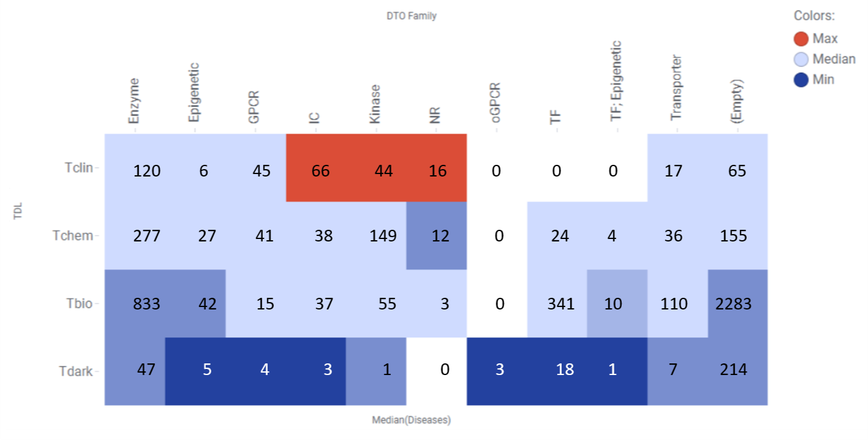
Rare diseases – target associations
NRDD paper in progress with Erik Tambuyzer, Marco Prunotto et al.
1/16/19 revision

Slide 50
Take Home Message machine learning models are laying the foundations of AI in Drug discovery
the age of AI-driven
drug/target discovery is upon us
(but we’re not there yet)
2/27/18 revision

Slide 51
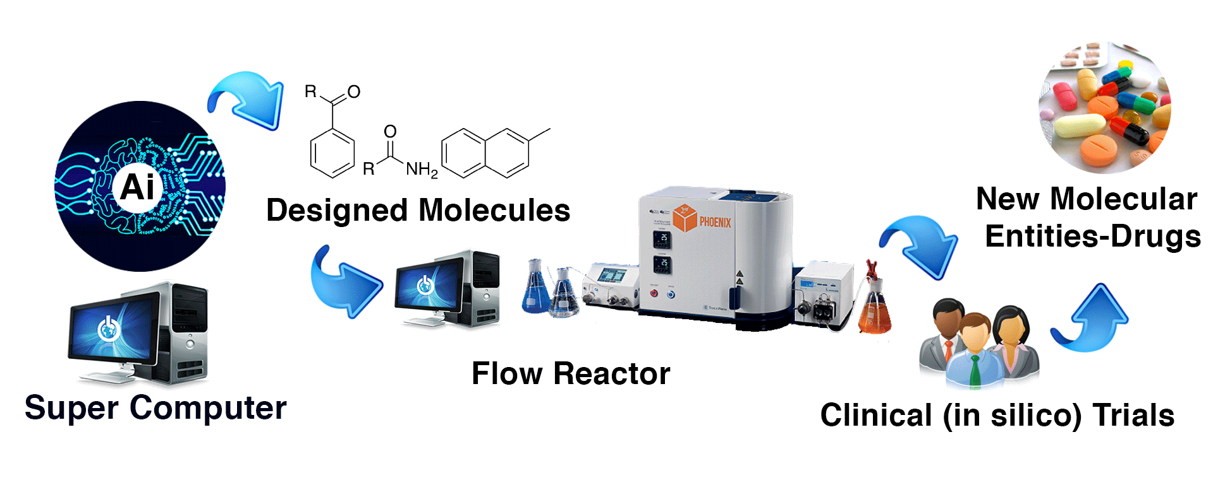
In the near future: drug discovery by AI
AI
The ones who are crazy enough to think that they can change the world, are the ones who do.
Steve Jobs -1997
Image conceived by Jayme Holmes, Oleg Ursu and Tudor Oprea. Quote credit: J Holmes.
4/18/18 revision

